Slide 1
Chapter 7: The excretory system removes waste products

Slide 2
7.1 The organs that process and remove wastes
Several organs in the body are involved either in the processing of wastes or in the excretion of those wastes.
Lungs: involved in the excretion of the carbon dioxide that is produced by all body cells during cellular respiration
Liver: processes many substances so that they can be excreted
Sweat glands in the skin: secrete sweat, which is largely water, for cooling
Alimentary canal: passes out bile pigments, which enter the small intestine with the bile
Kidneys: principal excretory organs, responsible for maintaining the constant concentration of materials in the body fluids.

Slide 3

7.2 The liver and skin
Liver
The liver is located in the upper abdominal cavity.
It is a very large organ with a host of different functions, one of which is the preparation of materials for excretion.
The liver plays an important role in processing chemicals into a safer form. For example, it converts ammonia produced from proteins into the safer form of urea by a process called deamination.
Deamination uses enzymes to remove the amino group (NH₂) from the amino acids. Once the amino group has been removed, it is converted by the liver cells to ammonia (NH₃) and then finally to urea, where it is eliminated from the body in urine.
The remaining part of the amino acid, which is mainly carbon and hydrogen, is converted into a carbohydrate that can be readily broken down by the cells to release energy, carbon dioxide and water.
Deamination:

Slide 4
7.2 The liver and skin
The liver also:
detoxifies alcohol and other drugs
deactivates many hormones and converts them into a form that can be excreted by the liver
breaks down haemoglobin from dead red blood cells to produce bile pigments, which are then passed out of the body with the faeces.

Slide 5
7.2 The liver and skin
Skin
The main functions of the skin are to provide a protective covering over the surface of the body and to regulate body temperature
Also plays a very important role in excretion
Dissolved in the water are sodium chloride, lactic acid and urea – these are being secreted from the body.
Sweat glands are located in the lower layers of the skin.
A duct carries the sweat to a hair follicle or to the skin surface where it opens at a pore.
Cells surrounding the glands are able to contract and squeeze the sweat to the skin surface.

Slide 6
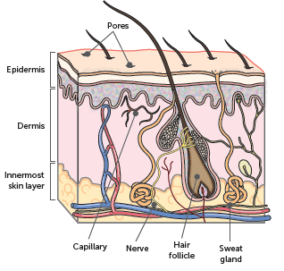
7.2 The liver and skin
The structure of skin, including sweat glands

Slide 7
7.3 The kidneys
Kidneys
The kidneys are located in the abdomen and each kidney is approximately 11 cm long. The kidneys, bladder and their associated ducts make up the urinary system.
The kidney is enclosed by the renal capsule. Under this is the outer renal cortex, the inner renal medulla, and then the renal pelvis sits in the concave side of the kidney. The renal hilum lies on the concave surface of the kidney, and is where the vessels enter and leave. The medulla consists of a number of renal pyramids, which are separated by renal columns, where the blood vessels lie.

Slide 8
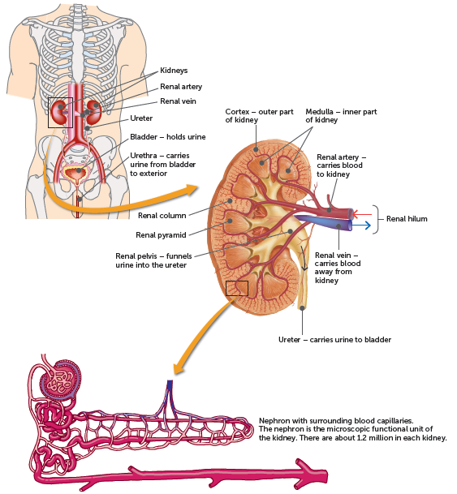
7.3 The kidneys

Slide 9
7.3 The kidneys
Structure of nephrons
The kidney is composed of a large number of microscopic structures called nephrons and collecting ducts. The nephron is the functional unit of the kidney, as it is where the urine is formed. There are about 1.2 million nephrons in each human kidney, and each is surrounded by a complex network of blood capillaries.
They are responsible for removing wastes from the blood and regulating blood composition. Blood enters the kidney through the renal arteries. Approximately 1.2 L of blood pass through the two kidneys every minute.
Blood enters the nephron through the afferent arteriole. It is filtered in the glomerulus, a network of capillaries, and then exits via the efferent arteriole.

Slide 10
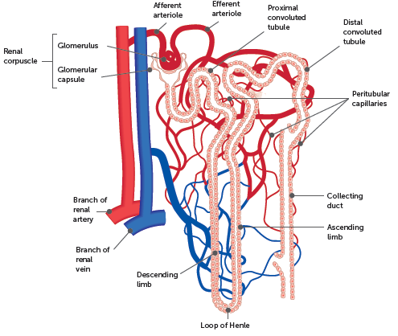
7.3 The kidneys

Slide 11
7.3 The kidneys
Production of urine
The formation of urine by the nephrons of the kidneys involves three major processes: glomerular filtration, selective reabsorption and secretion by the tubules.
Glomerular filtration takes place in the renal corpuscle when fluid is forced out of the blood and is collected by the glomerular capsule.
Many of the components of the plasma that are filtered from the capillaries of the glomerulus are of use to the body, therefore some selective reabsorption of the filtrate must take place, returning them to the blood in the peritubular capillaries. These processes are carried out by the cells that line the renal tubule.
Tubular secretion adds materials to the filtrate from the blood, such as potassium, hydrogen ions and creatinine. This process maintains blood pH and urine pH.

Slide 12
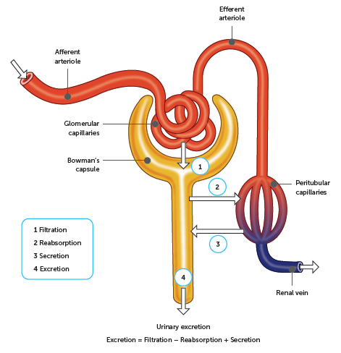
7.3 The kidneys

Slide 13
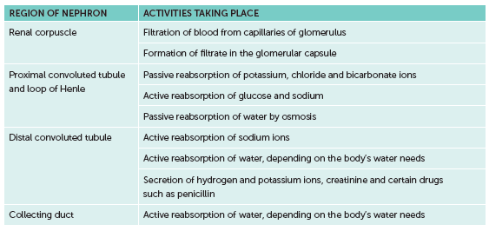
7.3 The kidneys
Water and other substances not reabsorbed drain from the collecting ducts into the renal pelvis. From the pelvis, the urine drains into the ureters and is pushed to the urinary bladder where it is stored. The two ureters, one from each kidney, extend to the urinary bladder. The urethra carries urine from the bladder to the exterior of the body.
Summary of the functioning of the kidney

Slide 14
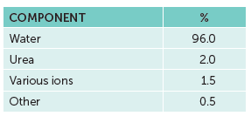
7.3 The kidneys
Composition of urine
Normal urine is a solution of water with dissolved wastes, such as urea and creatinine, and ions such as sodium, chloride and potassium, as well as low levels of other solutes.
A healthy adult produces about 1.5 L of urine a day, but this varies depending on diet, environment and other factors.
Composition of urine (guide only)

Slide 15
7.4 Effects of lifestyle on excretion
Kidney stones
Kidney stones are formed from solid crystals that build up inside the kidneys. They usually form when urine becomes too concentrated.
Small crystals may pass unnoticed, or crystals may combine to form stones. Large stones can get stuck in the ureter, bladder or urethra, causing intense pain, and may need to be broken up with sound waves or physically removed during surgery.

Slide 16
7.4 Effects of lifestyle on excretion
Kidney failure
One in three adult Australians is at risk of developing kidney disease. Most kidney diseases affect the glomeruli, reducing their ability to filter the blood. Protein and sometimes red blood cells may leave the blood at the glomerulus and will then be present in the urine. If excessive proteins are lost in the urine, blood protein levels fall and fluid accumulates in the tissues, causing swelling of the hands, feet, face or other areas.
When the kidneys lose their ability to excrete waste and to control the level of fluid in the body, this is known as kidney failure. Factors such as diabetes, high blood pressure or kidney diseases slowly destroy the nephrons in the kidneys. Eventually, the only way to maintain life is by dialysis or a kidney transplant.
Lifestyle measures to maintain healthy kidneys include: maintain a healthy diet and weight, abstain from smoking, drink water instead of sugary drinks, drink alcohol in moderation and do not use performance-enhancing drugs.

Slide 17
7.4 Effects of lifestyle on excretion
Liver disease
When the liver is not able to function effectively, it is unable to process toxins ready for elimination. Liver disease can be caused by infection, autoimmune problems, genetic disorders, cancer, and lifestyle factors such as excessive alcohol consumption and a fatty diet.
Symptoms include a yellow tinge to the skin (jaundice), abdominal pain and swelling, swelling in the legs and feet, nausea or vomiting, fatigue, dark urine, and faeces that are pale or dark coloured.

